Slide 1

Stoic Solutions
Keep America Beautiful - Litter Detective (Machine Learning)
Dr. Wesley Schultz & Dr. Kristin Stewart
Team Leader: Chris Bertram
Project Manager: Adam Hebel
Documentation/Training: Brian Rattanasith
Programmers: Jerry Compton, Jordan Mower, Enrique Jimenez
Database Admin: Connor Myers
System Analyst/Research: Matthew Adamus

Slide 2
Agenda Overview
Quick Background
Project Requirements
Project Management
Analysis of Design Decisions
Demonstrations of Product
Documentation
Notes:
Chris slide 1

Slide 3
Customer Project Proposal
Litter is one of the major environmental issues of the coming decade. Improperly disposed objects contaminate waterways, pollute open areas, and reduce the visual appeal of natural spaces around the world. And to make matters worse, litter is largely comprised of synthetic materials like plastics which take decades to biodegrade, and much of it ends up floating in the ocean as marine debris. There are currently major initiatives in the United States and around the world to clean and prevent litter and marine debris. But how much litter is there? And are these efforts making a difference?
The project involves resurrecting the previously-developed machine learning algorithm, refining the algorithm to include a 360-degree image capture, implementing and validating the algorithm with a sample of test images, and then pulling images from across the defined region using Google Streets and coding these images using the machine learning algorithm. These litter codes will then be passed to Team 2. The main goals are: 1.Pull images from Google Streets, 2.Collate images for ML processing to represent a defined geographic area, 3.Apply the ML algorithm to count the number of littered items in the geographical area.
Notes:
Chris slide 2

Slide 4
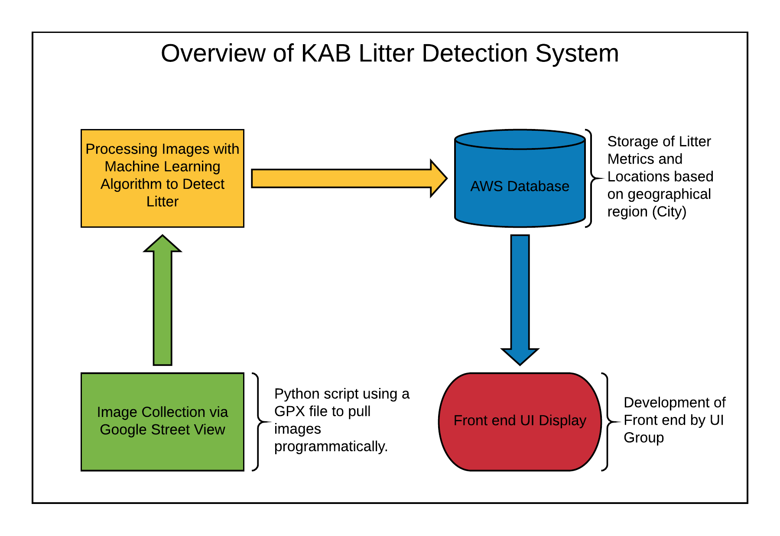
Project Requirements
Pull images from Google Streets.
Collate images for ML processing to represent a defined geographic area.
Apply the ML algorithm to count the number of littered items in the geographical area.
Create a database that holds all litter metrics for the UI team to utilize.
Notes:
Chris slide 3

Slide 5
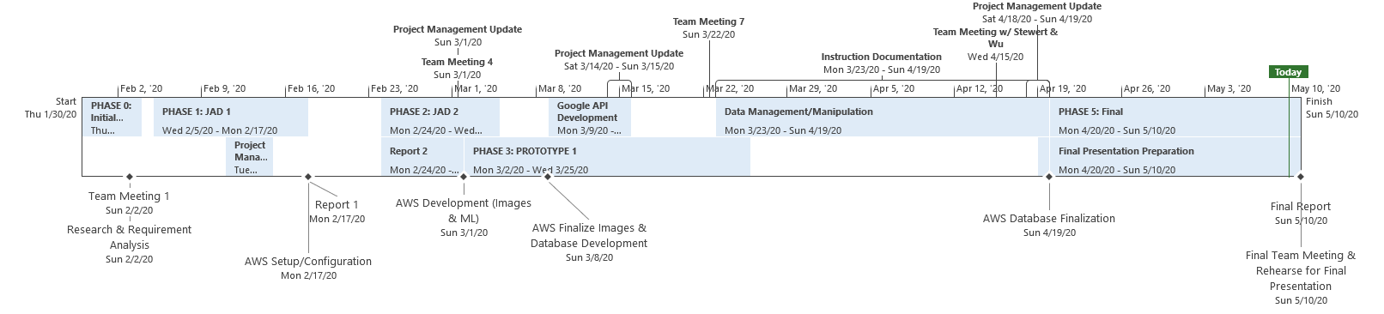
Project Management
Main tasks, projected onto timeline, correlates with our Gantt Chart
Milestones given below
Notes:
Brian & Adam slide 1

Slide 6
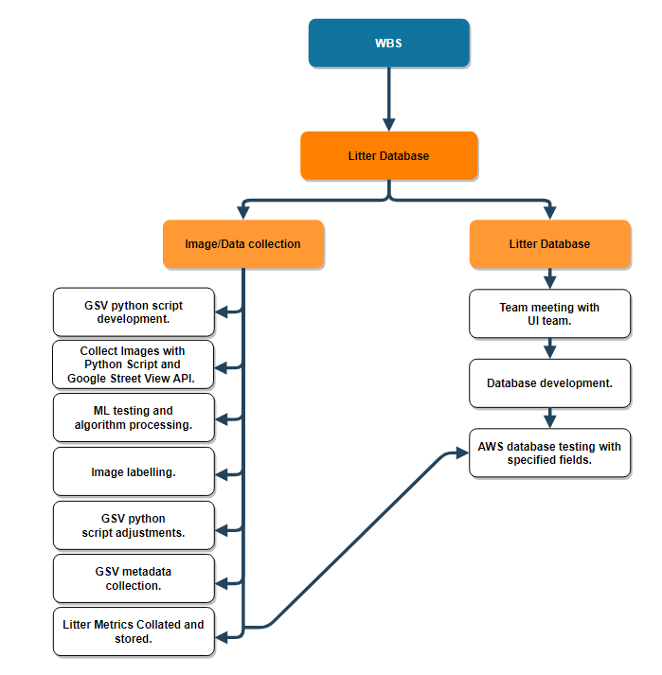
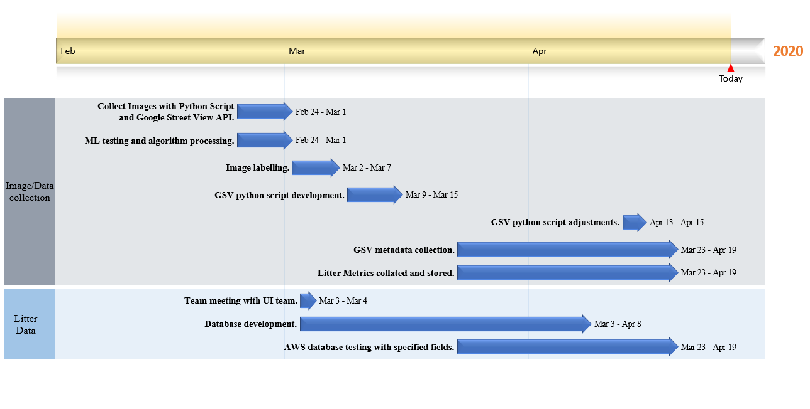
Project Management Cont.
Notes:
Brian & Adam slide 2

Slide 7
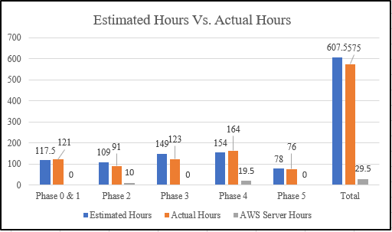
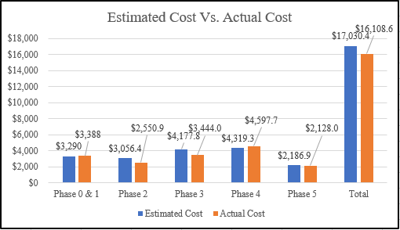
Project Management Cont.
Stoic Solutions operating at $28.00 dollars per hour, AWS ML ran at $.29 cents per hour
Phase Run Downs
Phase explanation
Most time estimated allocated vs actual time
AWS uptimes
Notes:
Brian & Adam slide 3

Slide 8
Requirement #1 :Pulling Images from Google Street View
Design decisions:
Design decision # 1: Research revealed that Google’s Street View API does not provide a reliable way to define a geographical region in this context.
Use of the API requires that you know the coordinates before you query. Brute forcing all possible coordinate pairs for every street in a region isn’t possible either. (We know, because we tried)
Brute forcing at 36 foot spacing would require trying ~129,289,514 different coordinate pairs!
Bounding Box of San Marcos: 33.080569, 33.188339, -117.2302626, -117.1102946
ΔLatitude = .107770, ΔLongitude = .119968.
Using 36ft (.01112 km) = .0001 decimal degrees.
Notes:
Jordan slide 1

Slide 9
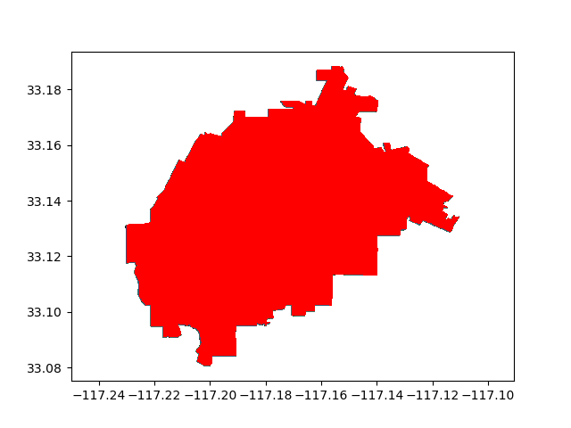
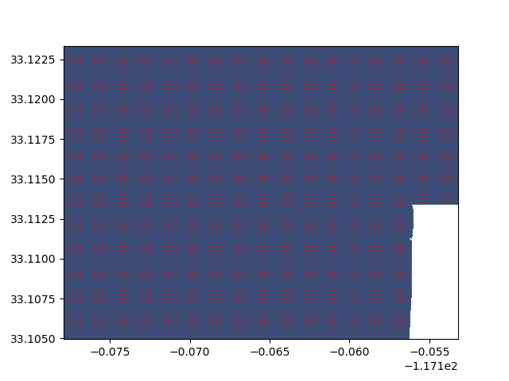
Example of Brute Force
We attempted to brute force using Open Street Maps at 100 ft spacing (.002741 decimal degrees).
Overview of San Marcos
Closer look at San Marcos
Notes:
Jordan slide 2

Slide 10
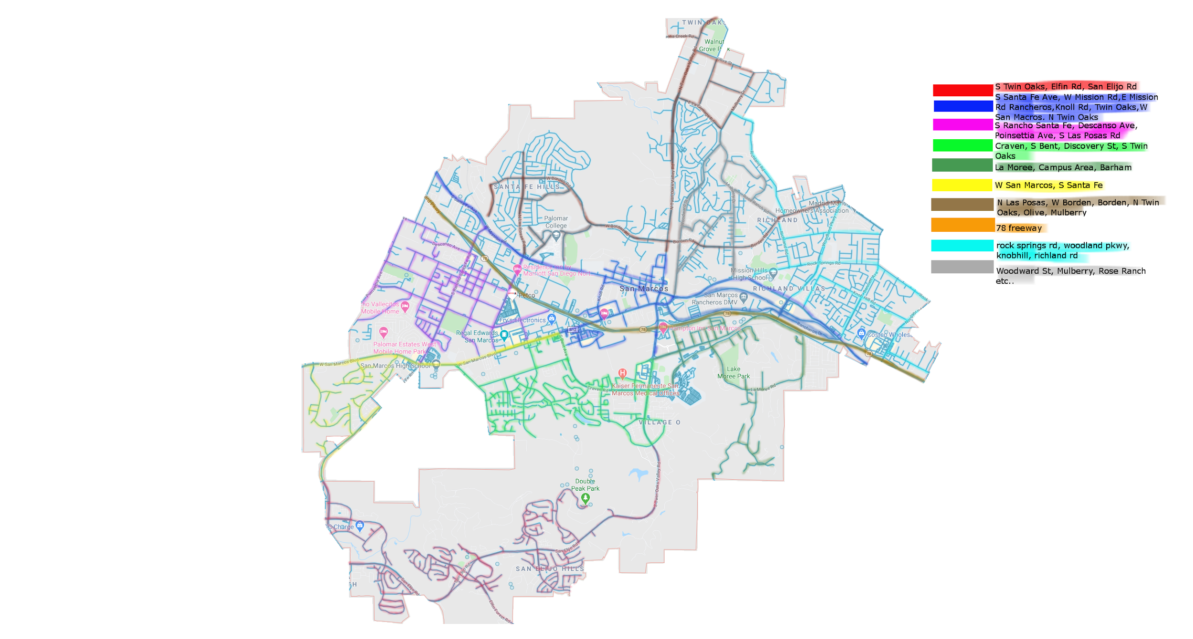
Implementation of Design Decision #1
Manually map routes along the streets of San Marcos using plotaroute.com.
Pros:
Allows us to generate coordinate pairs from the GPX Files from the streets.
Easily parsed and passed to Google Street View API.
Set of coordinates is manageable (approximately 500 foot intervals).
Cons:
Data has a lower resolution
Time intensive
Prone to human error
Not easily scaled to other cities
Rough estimate of plotted routes
Notes:
Jordan slide 3

Slide 11
Design Decision #2: 4 Images or 2?
Design decision #2 :Is it necessary to use all four images from the panorama?
Our team came to the conclusion that gathering images from the sides of the street would produce the best results.
Most litter present on the street is pushed to the sides by cars.
Only capturing left and right images halves our API calls and processing time reducing overall expenses.
This requires determining a bearing between two points of latitudes and longitudes then capturing the view +90° and -90° from that bearing.
Notes:
Jerry slide 1

Slide 12
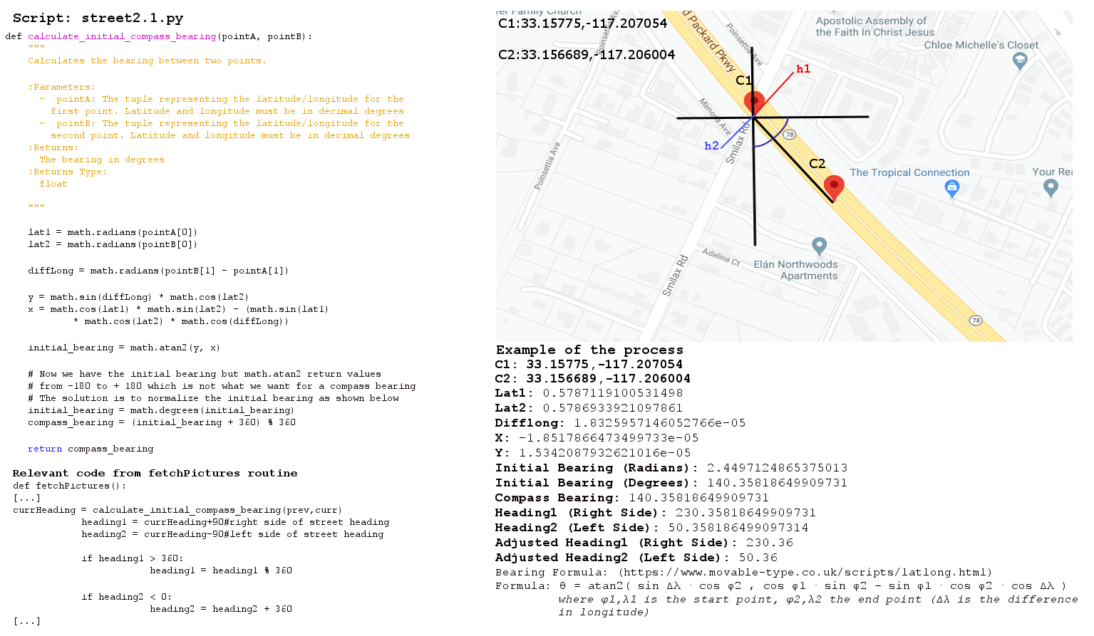
Implementation of Design Decision #2
Notes:
Jerry slide 2

Slide 13

Demonstration of street2.1.py
Notes:
Jerry slide 3

Slide 14
Processing Images on Machine Learning Server
Processing images was straight forward.
Modified the script from fixIT team (2018) to write to a text file.
However it takes a long time to process a batch of images.
In our case, we had 4,216 images and it takes approximately 6 seconds per image.
4,216 * 6s = 25,296s
25,296s = 7.03 hours
Notes:
Jordan slide 4

Slide 15
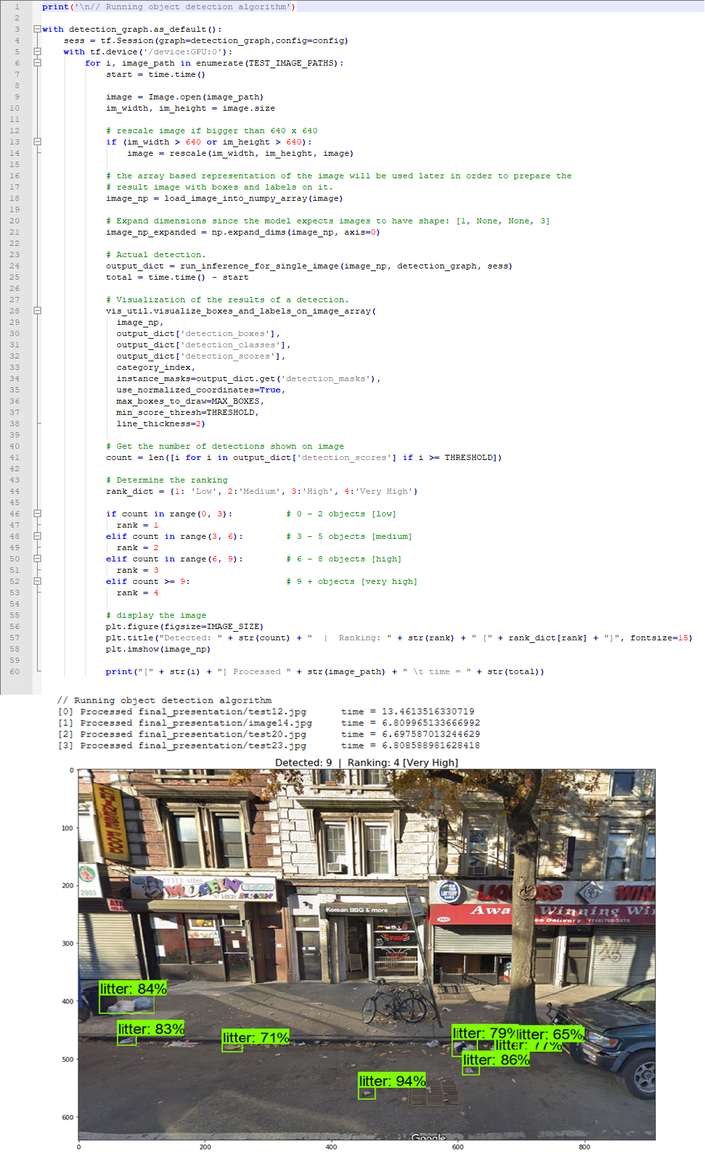
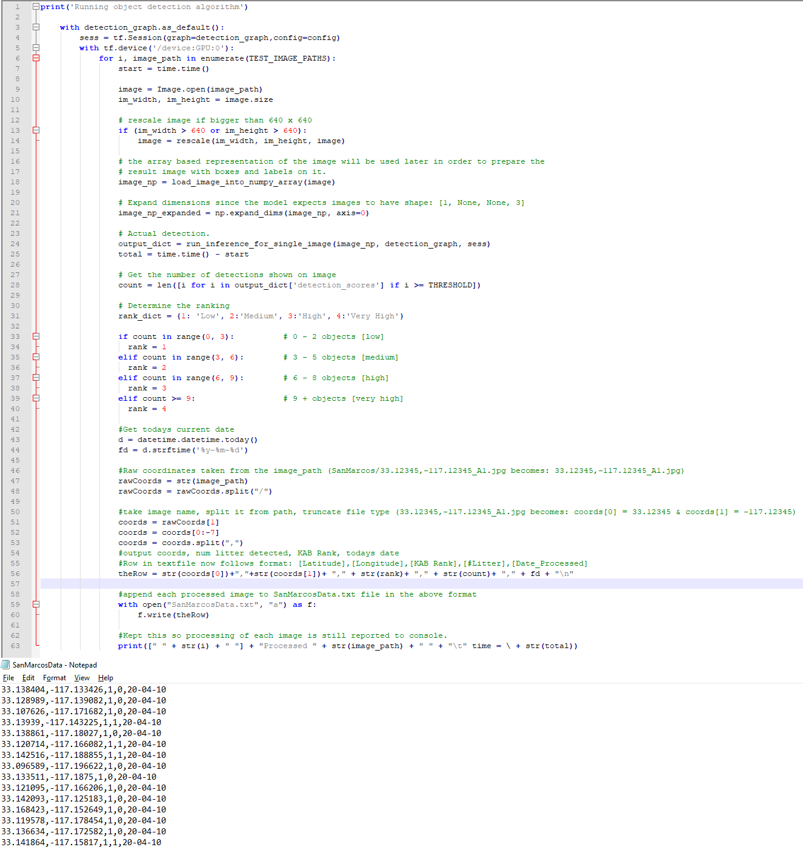
Script Modifications
fixIT (2018) Script
Stoic Solutions Script
fixIT (2018) Script was modified to produce processed data in the format that our database could use.
Notes:
Jordan slide 5

Slide 16
Collating and Posting to Database
Two coordinate pairs for each angle exist.
Sum litter counts from each pair of coordinates
Remove any duplicates
Update KAB Rating to reflect new litter count
Post data to database using PyMySQL
(Angle1_#LitterPieces + Angle2_#LitterPieces) = Total #LitterPieces PER Coordinate
How KAB Litter ranks are determined:
1 = 0-2
2 = 3-5
3 = 6-8
4 = 9+
Example:
[Angle1] : 33.159253,-117.203276,1,1,20-04-10
[Angle2] : 33.159253,-117.203276,2,3,20-04-10
[33.159253,-117.203276]: 1 + 3 = 4
[33.159253,-117.203276]: KAB Rank = 2
[Lat, Lon, KAB_Rank, litter_count, date]
Notes:
Connor slide 1

Slide 17
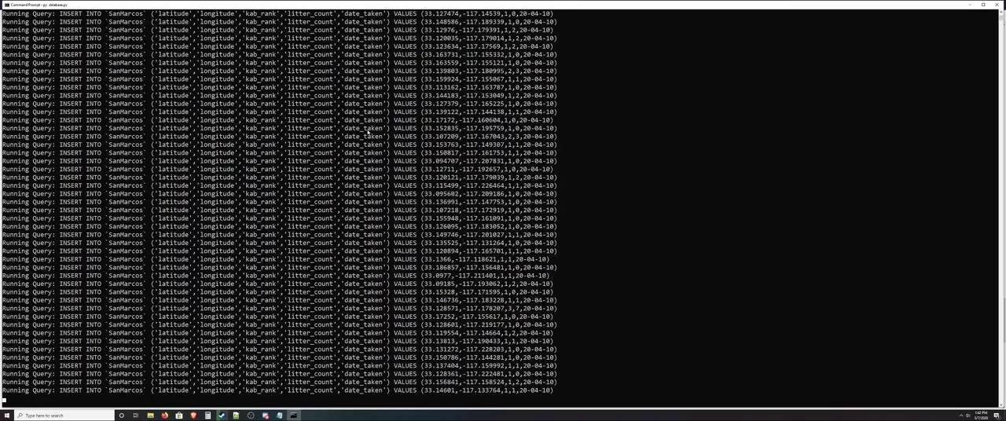
Demonstration of database.py
Notes:
Connor Slide 2

Slide 18
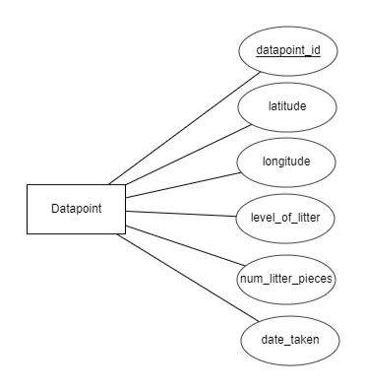
Database Schema
CREATE TABLE SanMarcos (
datapoint_id INT(11) AUTO_INCREMENT,
latitude double,
longitude double,
kab_rank FLOAT,
litter_count FLOAT,
date_taken DATE,
CONSTRAINT datapoint_id_pk PRIMARY KEY(datapoint_id));
datapoint_id
latitude
longitude
City
kab_rank
litter_count
date_taken
Notes:
Connor slide 3

Slide 19
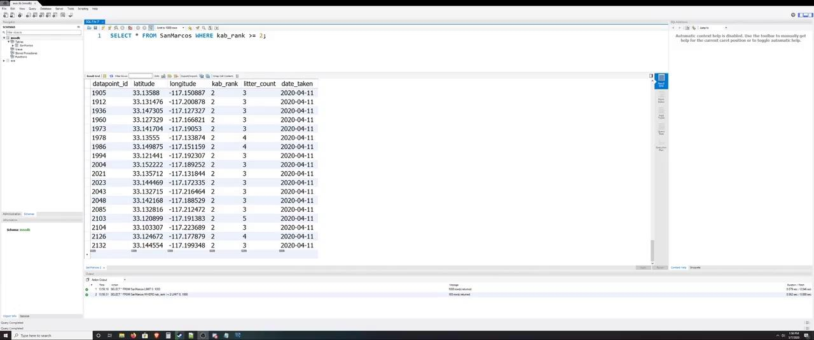
A look at the database
Notes:
Connor slide 4

Slide 20
Deliverables
Street2.1.py
Python script used for parsing GPX files, fetching images from Google Street View, and storing them locally on a machine.
StoicSolutions_KABProcessor.ipynb
Python script used for processing images on the machine learning server and saving image data to a text file in the format: [Latitude],[Longitude],[KAB Rank],[Litter Count],[Date Processed].
SanMarcosData.txt
Text file produced by StoicSolutions_KABProcesser.ipynb containing data for all processed images. This data is unrefined and is not representative of what will appear in the database. Mainly, there will exist duplicate latitude/longitude pairs because each coordinate produces two angles.
Database Implementation & Details
Database ERD (Entity Relationship Diagram)
Database credentials and access parameters.
Notes:
Matthew slide 1

Slide 21
Documentation
Storing all our files, manuals, and documents on GitHub.
Also storing some of the fixIT (2018) teams files that we used.
Storing it on GitHub allows any future groups to view and download our project.
Provides long-term storage and documentation.
All deliverables are located in the GitHub link located below.
https://github.com/stoicSolutions/cis490_2020_project
Notes:
Matthew slide 2

Slide 22
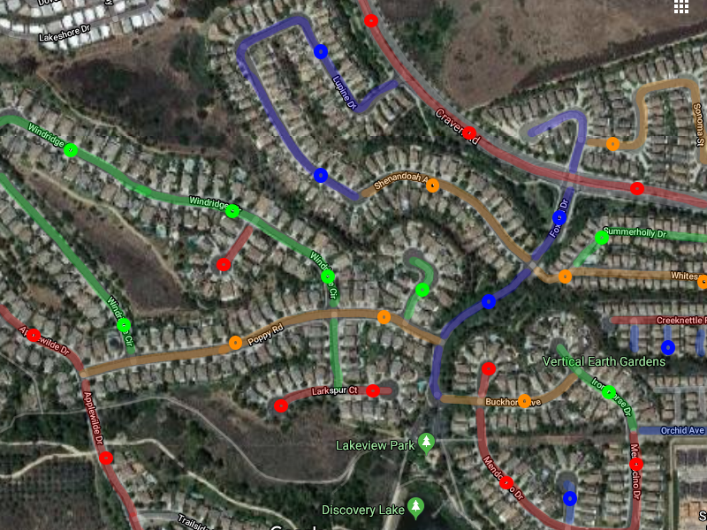
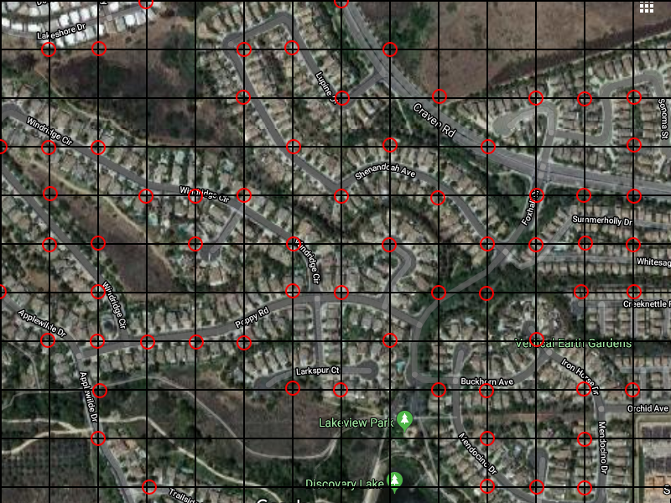
Future Enhancements
Sample an entire Zip code via uniform spacing?
Sample an entire Zip code via unique street name? It already exists! OSMnx
Notes:
Matthew slide 3

Slide 23
Future Enhancements
Image collection automation
Currently, our method of obtaining the GPX files are through manually inputting them into a website called plot-a-route.
In order to scale up geographically, an automated method of coordinate polling would be needed.
Notes:
Enrique slide 1

Slide 24
Future Enhancements
Refining database structure to better suit larger geographic regions…
Since we were only able to manually obtain data for San Marcos, we did not need to design a database structure that was designed to consider relationships between city, county, state, or country.
Dream Objective: To simply enter a Zip code and polling interval and press go. Furthermore, allow the data from an initial survey every 200m to build half the data of a survey every 100m.
Notes:
Enrique slide 2

Slide 25
Future Enhancements
Machine learning algorithm improvements
The machine learning algorithm can be modified further to deliver results more efficiently and with fewer costs.
Algorithm Modification to identify specific objects
Differentiate between pieces of litter
Bottles, bags, wrappers etc.
Notes:
Enrique slide 3

Slide 26
Stoic Solutions: Q&A
Special thanks to Dr. Wu, Dr. Stewart, and Dr. Schultz
Notes:
That’s all folks!

